Slide 1
Discussion 4: Inheritance

Slide 2
Disclaimer
There will be a lot of “Java rules” for the next week or so; bear with us!

Slide 3
Agenda
Problem 1
Mini lecture and Problem 2
Mini lecture and Problem 3
Problem 4 at your own pace

Slide 4
Administrivia
Project 1B and 1Gold released, due Saturday 2/16
Lab this week is peer-code review; attendance is required!
Midterm 2/20, 8-10 PM, see midterm post for more details
Room assignments out later on
Guerrilla section this Sunday 2/17 from 2-4pm in 271, 273, 275 Soda
One-on-one tutoring sign ups on Piazza weekly
Resources: tinyurl.com/cz-disc4-sp19
Resources: tinyurl.com/cs61b-christine-zhou

Slide 5
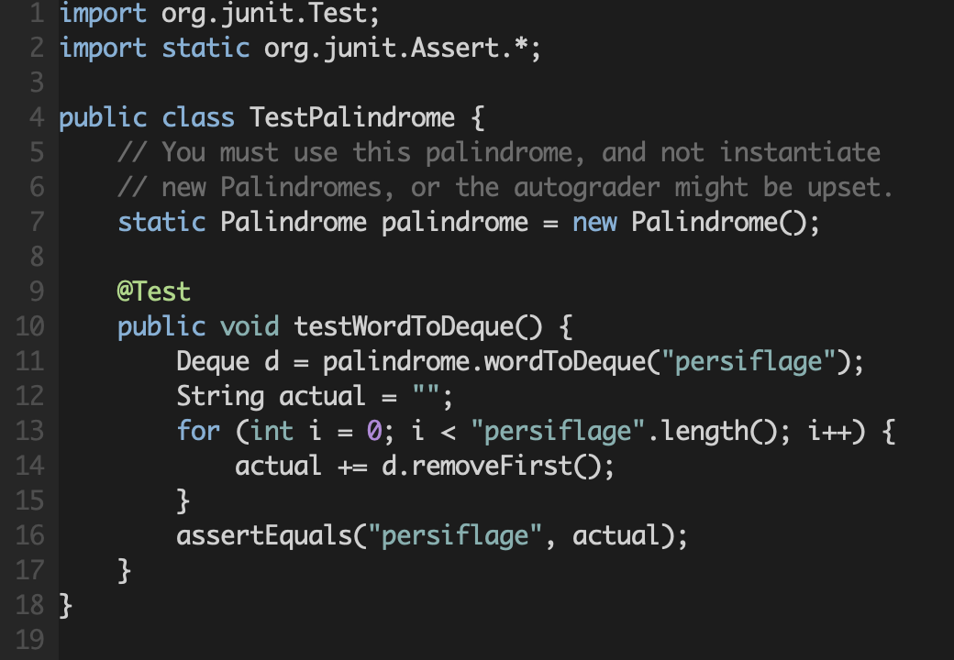
JUnit Testing

Slide 6
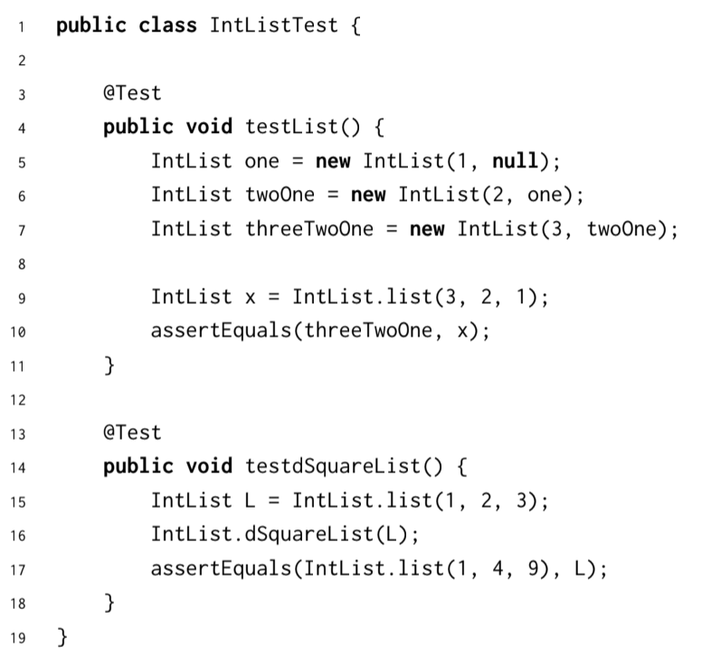
JUnit Testing
What are the advantages and disadvantages of writing JUnit tests?
Advantages:
1. Organized code - each test corresponds to different part of program
2. Can debug code locally
3. Documentation that your program works
4. Can reduce the amount of test code you need to write because you can reuse code
Disadvantages:
1. Hard to use for higher-level testing (integration testing)

Slide 7
Review: Inheritance
public class Fish {
String name;
public Fish(String name) {...}
Public void eat() {...}
public void blink() {...}
}
public class Goldfish {
String name;
public Goldfish(String name) {...}
public void eat() {
print(“bloop”);
...
}
public void blink() {...}
}

Slide 8
Inheritance: extends
extends (can extend only one class)
Inherits all fields, methods, and nested classes
Constructor is not inherited, but there will be an implicit call to super( ) in the beginning of the subclass’s constructor (need to make the Superclass before making the Subclass)
If the Superclass’s constructor requires arguments, you must write an explicit call to super!
Fish() { Goldfish() {
this.name = “Bob”; super();
this.age = 12; this.name = “Bobfish”;
} }
------------------------------------------------------------------------------
Fish(String name) { Goldfish(String name) {
this.name = name; super(name);
this.age = 12; this.name = “Bobette-fish”;
} }

Slide 9
Review: Inheritance
public class Fish {
String name;
public Fish(String name) {...}
Public void eat() {...}
public void blink() {...}
}
public class Goldfish extends Fish {
public Goldfish(String name) {
super(name); // need to have this!
...
}
public void eat() {
print(“bloop”);
super.eat();
}
}

Slide 10

Creating Cats
What will Cat inherit from Animal?
How can we rewrite as little code as possible?

Slide 11
Creating Cats
public class Cat extends Animal {
public Cat(String name, int age) {
super(name, age); // Call superclass' constructor.
this.noise = "Meow!"; // Change the value of the field.
}
@Override
public void greet() {
System.out.println("Cat " + name + " says: " + makeNoise());
}
}
Notes:
Don’t need to override makeNoise because it does exactly what we want and will access Cat’s noise, “Meow!”
Don’t have to redeclare name, noise, or age because all fields are inherited
Why super(name, age)?
If no call to super, Java will default call super(); at the beginning of the constructor. Since Animal doesn’t have a default constructor with no arguments not making a call to super would give you a compile time error.

Slide 12
Review: More Inheritance
Anything that lives in water must have these two methods: float(), swim()
If we have a Fish or SeaOtter class, it must have these!
How do we guarantee this?

Slide 13
Inheritance: implements
Let’s define an interface, all classes that implement this interface must have all the methods
Can implement multiple interfaces
public interface WaterBeing { public class Fish implements WaterBeing {
public void swim(); public Fish() {...}
public void float(); @Override
} public void swim() {...}
@Override
public void float() {...}
}

Slide 14
Review: More Inheritance
Can also have abstract classes
A normal class with one or more “abstract” things (method/variable)
Any subclass must implement the abstract things, or it will also be an abstract class
Cannot be instantiated (how can you instantiate something when the behavior is abstract?)
public abstract class Fish { public class Goldfish extends Fish {
... ...
public abstract void bloop(); public void bloop() {...}
public void swim() {...} }
}

Slide 15
Review: Static vs. Dynamic Types
Fish f = new Goldfish()
Fish is the static type, this is what Java looks at during compilation
Goldfish is the dynamic type, this is what Java looks at during runtime
The dynamic type can be any subclass of the static type
Does Fish b = new Goldfish() work?
How about Goldfish c = new Fish()?
Casting changes the static type of an object temporarily
Fish d = new Goldfish();
((Goldfish) d).bloop(); // static type of d is Goldfish for this line
d.bloop(); // static type of d is Fish

Slide 16
Overriding/Overloading
public class Fish {
int weight;
public Fish(int w) {
weight = w;
}
public void swim() {
System.out.println(“splash”);
}
}
public class Salmon extends Fish {
String home;
public Salmon(int w, String h) {
super(w);
home = h;
}
public void swim() {
System.out.println(“splish splash”);
}
public void swim(int speed) {
System.out.println(“swimming at “ + speed + “ mph”);
}
}
Overriding: exact same method signature
Overloading: same name, different parameters
Notes:
The parameters have to be exactly the same to be overriding.
i.e. swim(Salmon fish) is not overriding swim(Fish fish)
Overriding is tied to inheritance, Overloading is not

Slide 17
Review: Static vs. Dynamic Types
Method lookup in non-static contexts:
During compilation:
Check if the method exists in the static type
If doesn’t exist, go to the superclass and repeat
If no superclass, compile time error
During runtime:
Run the method in the dynamic type (dynamic method selection), if not in the current class, go to the parent, and then the parent…
The method has to have the exact same signature as the one found during compilation.
Is this overloading or overriding?
Overriding! Only overriding has to do with inheritance. Overloading does not.

Slide 18
Dynamic Method Selection
Compile time: static method lookup, check if the static type has that method
Run time: dynamic method lookup (for overridden methods only!), use the method of the dynamic type
Fish fish = new Fish();
Salmon salmon = new Salmon();
Fish bob = new Salmon();
fish.swim();
salmon.swim();
bob.swim();
fish.swim(5);
salmon.swim(5);
bob.swim(5)
Notes:
Dynamic method selection happens for overridden methods only.
If the static type doesn’t have the method, it’s a compiler error, EVEN if the dynamic type does have it.
Compile time: static method lookup
Run time: dynamic method lookup
At run time, must use a method with the same exact method signature as looked up at compile time.

Slide 19
Dynamic Method Selection
Compile time: static method lookup
Run time: dynamic method lookup
Fish fish = new Fish();
Salmon salmon = new Salmon();
Fish bob = new Salmon();
fish.swim();
salmon.swim();
bob.swim();
fish.swim(5);
salmon.swim(5);
bob.swim(5)
splash
splish splash
splish splash
compile-time error
swimming at 5 mph
compile-time error
Notes:
Notice for bob.swim(), Salmon’s swim() method is run because bob’s dynamic type is Salmon
Fish doesn’t have a swim(int x) defined

Slide 20

Raining Cats and Dogs
Remember dynamic method lookup for overridden methods
Casting forces the compile-time type of an object
johnsu.deviantart.com/art/Raining-Cats-and-Dogs-30291521

Slide 21
Raining Cats and Dogs
Animal a = new Animal("Pluto", 10);
Cat c = new Cat("Garfield", 6);
Dog d = new Dog("Fido", 4);
a.greet(); // (A) Animal Pluto says: Huh?
c.greet(); // (B) Cat Garfield says: Meow!
d.greet(); // (C) Dog Fido says: WOOF!
a = c;
((Cat) a).greet(); // (D) Cat Garfield says: Meow!
a.greet(); // (E) Cat Garfield says: Meow!
Notes:
After a = c, a’s static type is Animal but its dynamic type is Cat.
The casting doesn’t change anything in this case because both Cat and Animal have the greet() method and the dynamic type (Cat)’s greet() will be used at runtime

Slide 22
What if we added this line?
Animal a = new Animal("Pluto", 10);
Dog d = new Dog("Fido", 4);
a = new Dog("Spot", 10);
d = a;
Compiler error because the static type of d is Dog and the static type of a is Animal. We can fix this by casting:
d = (Dog) a;

Slide 23
An Exercise in Inheritance Misery (Extra)
class C extends B {
public int y = x + 1;
public void m2() {System.out.println("Cm2-> " + super.x);}
/*public void m4() {System.out.println("Cm4-> " + super.super.x); }} can't do super.super */
public void m5() {System.out.println("Cm5-> " + y);}
}
Notes:
The definition of m4 doesn’t compile because we’re not allowed to do super.super
What if there is no grandparent class? every class inherits from Object so a parent is guaranteed

Slide 24
An Exercise in Inheritance Mystery (Extra)
\\ B a0 = new A(); Dynamic type must be B or subclass of B
\\ a0.m1(); cascading: prev line failed, so a0 can't be initialized
\\ a0.m2(16); cascading: prev line failed, so a0 can't be initialized
Notes:
This whole part doesn’t compile because you’re not allowed to say Subclass a = new Superclass();

Slide 25
An Exercise in Inheritance Mystery (Extra)
A b0 = new B();
System.out.println(b0.x); [prints "5"]
b0.m1(); [prints "Am1-> 5"]
b0.m2(); [prints "Bm2-> 5"]
\\ b0.m2(61); m2 (int y) not defined in static type of b0
Notes:
x is not declared in B, so field x from A is not hidden.
m1 is not overridden in B, so method from A is run
m2 is overridden in B, so method from B is run (b0’s dynamic type is B)
b0’s static type is A, which doesn’t contain a method with the signature m2(int y) so this would not compile

Slide 26
An Exercise in Inheritance Mystery (Extra)
B b1 = new B();
b1.m2(61); [prints "Bm2y-> 61"]
b1.m3(); [prints "Bm3-> called"]
A c0 = new C();
c0.m2(); [prints "cm2-> 5"]
\\ C c1 = (A) new C(); Can't assign c1 to an A
Notes:
b1 has static and dynamic type B, so it compiles and then runs the m2(int y) method from class B
Same for b1.m3();
c0 has static type A, and since class A has a method m2() it compiles. Then, since C overrode that method, it runs the m2() method defined in C
super.x refers to its parent class’s x. In this case it’s the field x from class B, which inherits the field from A. Since x hasn’t gone through any change it is still 5.
This last statement is interesting. To the compiler, this statement looks the same as this:
A staticTypeA =___________;
C c1 = staticTypeA;
This isn’t allowed! The compiler doesn’t know that the object on the right side of the equals sign is actually an instance of C

Slide 27
An Exercise in Inheritance Mystery (Extra)
A c0 = new C();
A a1 = (A) c0;
C c2 = (C) a1;
c2.m3(); [print Bm3-> called]
\\ c2.m4(); C.m4() is invalid
c2.m5(); [print Cm5-> 6]
Notes:
Things are getting hairy. c0, a1, and c2’s dynamic type is C. Remembering this is essential to the problem
c2 will run the m3() defined in B because class C inherits it from B.
C.m4 is invalid (the method definition in class C wouldn’t compile because you cannot say ‘super.super)
m5() from class C is run. This prints out y.
y in class C is defined to be x + 1
x is inherited from B, which is inherited from A, which is 5
So y in class C evaluates to 6

Slide 28
An Exercise in Inheritance Mystery (Extra)
A c0 = new C();
A b0 = new B();
((C) c0).m3(); [print Bm3-> called]
\\ (C) c0.m3(); NOT RUNTIME ERROR This would cast the result of what the method returns and it returns void therefore compile-time error
b0.update();
b0.m1(); [print Am1-> 99]
Notes:
Casting c0 does nothing here since C inherits the method m3() so it compiles fine. The method m3() inherited from class B is run.
This is as if you’re taking whatever c0.m3() returns, and trying to cast it to C.
Doesn’t compile because m3 returns void so it makes no sense to try to cast that result
b0 has dynamic type B and it never overrode the update() method so it runs the update() method defined in A.
This changes the field x to 99 for the b0 instance.
m1() from class A is run because B never overrode it. x is now 99 from the previous call to udpate.

